Slide 1
3D Edition
N.N.
NN@qt.qio
February 2017 – Based on Qt 5.8

Slide 2
Contents
OpenGL | OpenGL, OpenGL Libraries, OpenGL Pipeline, Buffers, Rendering, Texturing, Render Loops
Shaders | GLSL Shaders, Using Shaders in QML
OpenGL in Qt | Canvas3D, OpenGL and QtQuick
Qt 3D | Features, Entity Component System, Architecture, Frame graph, Materials, Effects
Data Visualization | Types, Item Model Use, Rendering, Customization, Performance

Slide 3
Objectives
Know different options of using 3D graphics in Qt
Learn 3D-related Qt modules
To be able to start or continue serious 3D graphics development with Qt framework using C++ or Qt Quick
Any questions at any point – please do not hesitate to ask!

Slide 4
OpenGL

Slide 5
Contents
OpenGL
OpenGL Libraries
OpenGL Pipeline
Buffers
Rendering
Texturing
Render Loops

Slide 6
OpenGL
Abstract API for high performance 3D(2D) rendering with a programmable graphics processor
Platform independent
State machine, where each command is executed in a state
No window or user interaction support
In desktops, OpenGL 3 or later is typically supported
In embedded platforms, OpenGL ES 2 or 3 are typically supported
OpenGL ES
A reduced version of OpenGL meant for embedded devices
Precision qualifiers in shaders (lowp, mediump, highp)

Slide 7
OpenGL Versions
OpenGL 1.3
Fixed pipeline, everything defined with flags and states
Chip vendor specific extensions – some programmable features
For example, ARB_debug_output => added to OpenGL Core profile in 4.3
OpenGL 2
Programmable pipeline
Vertex and fragment shaders introduced => many functions became obsolete
OpenGL 3
Support to create primitives dynamically using geometry shader
OpenGL 4
Support for tessellation

Slide 8
What Is Supported in My Platform?
In Qt, you may explicitly set, which OpenGL functions you want to use
QOpenGLFunctions – Cross-platform API to OpenGL ES 2 functions
QOpenGLFunctions_4_5_Core
Subclass from QOpenGLFunctions and initialize the functions
class GLWindow : public Qwindow, protected QOpenGLFunctions
// Create context and make it current
initializeOpenGLFunctions();
Provides common API for OpenGL 2 and OpenGL ES 2
Sub-class QOpenGLExtraFunctions provide the common API for OpenGL 3 and OpenGL ES 3
Another option is just to request the functions
QOpenGLFunctions_3_3_Core* functions = 0;
functions = QOpenGLContext::currentContext()->versionFunctions<QOpenGLFunctions_3_3_Core>();
if (!functions) { // No chance }

Slide 9
What Is Supported in My Platform?
Easy to check availability of a feature
QOpenGlFunction::hasOpenGLFeature(QOpenGLFunctions::BlendColor)
Shaders, Buffers, Framebuffers, Multitexture
QQmlContext may be used to check availability of an extensions in the library
QQmlContext::hasExtension(const QByteArray &extension)

Slide 10
OpenGL Libraries
Window system-specific libraries
Allows using OpenGL in a window system –based window
GLX, WGL (Windows), CGL (OS X), EGL (cross-platform interface between OpenGL and native window system)
Cross-platform libraries
GLFW - supports context, window, and input event management
OpenGLUT (Utility toolkit) – open-source, cross-platform interface between a window system and OpenGL
Provides more complicated primitives: cubes, primitives, Utah (Newell teapot)
GLEW (GL Extensions Wrangler) – streamlines dealing with OpenGL versions and their extensions
QtGui ☺
Window, context, input management and plenty of more

Slide 11
OpenGL and Window System
Create a window system-specific window for OpenGL
May support sharing resources between contexts
Window and context creations are not part of OpenGL specification
Context
State machine, storing all rendering related data
Color
Viewing and protection matrices
Drawing modes
Lighting
Materials
Anti-aliasing level

Slide 12
Qt Gui
In Qt, there is always a window
No matter if widgets, OpenGL, Qt Quick, or web engine is used
Possible to sub-class QWindow
Does not provide any render functions – must be implemented by the developer
Before rendering, an OpenGL context must be created and made current – API available in QOpenGLcontext
Window re-paint is requested with QWindow::update() in an event handler
For example, when an animation timer expires or any mouse, touch, key event changes the model
Custom event handler implemented for QEvent::UpdateRequest event, which calls the render() function
More convenient to use QOpenGLWidget or QOpenGLWindow
No need to explicitly manage the context object
Provide common API: initializeGL(), paintGL(), resizeGL()

Slide 13
QOpenGLWidget vs. QOpenGLWindow
Rather new classes, introduced in Qt 5.4
Similar APIs in both classes
initializeGL() – initialize your resources
resizeGL() – set the viewport or projection, when window size changes
paintGL() – render
Both render to FBO
Both supports partial rendering with QPainter

Slide 14
QOpenGLWidget vs. QOpenGLWindow
Function update() will request for a repaint – paintGL() function called
Avoid timers – use frameSwapped() signal instead
OpenGL context created automatically and made current
Both allow painting with QPainter and partial updates, made with QPainter
Easy way to have 2D UI controls in 3D scene
QOpenGLWindow does not have dependencies on widgets => slightly faster
Note that QOpenGLWidget is painted before other widgets (no matter of the stacking order)
You may use setWindowFlags( Qt::WindowStaysOnTopHint) to change that

Slide 15
OpenGL Contexts – QOpenGLContext
Managed by QOpenGLWidget and QOpenGLWindow
Access using the context() member
Associates the surface with the context
Context may be shared by all windows
Context may be shared by multiple threads
Use QObject::moveToThread()) and then make context current before using gl functions
Set the surface format with QSurfaceFormat
Render buffers: color, stencil, sample, alpha buffers
Swap behavior and interval

Slide 16
What Have We Achieved So Far?
Demo: basicOpenGLWindow
class OpenGLWindow : public QOpenGLWindow
{
Q_OBJECT public:
OpenGLWindow(QOpenGLWindow *parent = 0) {
QSurfaceFormat format;
format.setAlphaBufferSize(8);
format.setMajorVersion(4);
format.setMinorVersion(3);
format.setSamples(8);
format.setSwapInterval(10);
setFormat(format);
} ~OpenGLWindow(); protected:
void initializeGL() Q_DECL_OVERRIDE { }
void paintGL() Q_DECL_OVERRIDE { }
void resizeGL(int, int) Q_DECL_OVERRIDE { }
};

Slide 17
OpenGL Rendering Pipeline
Vertex array
Transformed vertices
Triangles (or lines etc.)
Vertex, tessellation, geometry
shaders
Primitive assembly
Rsterization
Rasterized fragments
Rasterized fragments
Framebuffer
Fragment shader
Testing
Blending

Slide 18
OpenGL Data Types
Data Type | C Type | Data Type | C Type
GLboolen | unsigned char | GLdouble | double
GLbyte | char | GLbitfield | unsigned int
GLchar | char | GLfloat | float
GLshort | short | GLclampx | int
GLushort | unsigned short | GLclampf GLclampd | float [0, 1] double [0, 1]
GLint | int | GLsizei | int
GLfixed | int | GLintptr | int
GLsizei | int | GLsizeptr | int
GLenum | unsigned int | GLvoid | void
OpenGL ES does not support 64-bit data types

Slide 19
OpenGL Object Model
Data is provided to OpenGL with objects
Object names (handles) are opaque (managed internally by OpenGL) GLuint values
Handles are created using glGen* functions
glGenBuffers(GLsizei nofBufferObjectNames, GLuint *arrayOfObjectNames)
glGenVertexArrays() // Since OpenGL 3
glGenTextures()
Objects are used by binding their names to OpenGL target (GL_ARRAY_BUFFER, GL_ELEMENT_ARRAY_BUFFER, GL_TEXTURE_2D) using glBind* functions
glBindBuffer(GLenum target, GLunit bufferName)
glBindVertexArray(GLunit arrayName) // Since OpenGL 3
glBindTexture()

Slide 20
Buffer Objects
Vertex buffer object (VBO)
Contains vertices and vertex attributes
Location, texture coordinates, normals, colors
Rather easy to convert from Wavefront .obj format
Index buffer object (GL_ELEMENT_ARRAY_BUFFER)
Array of indices (index = a pointer to a single vertex in the vertex array)
Easy to re-use the same vertices without defining each vertex several times
Defines, which vertices are fed into the pipeline
Defines how to construct the faces of a mesh (triangles) based on VBO objects
Some devices only support GLushort/GLubyte type indices
Vertex buffer without indexing: { v₀, v₁, v₂, v₀, v₃, v₁ }
Vertex buffer with indexing: { v₀, v₁, v₂, v₃ }
Index buffer: { i₀, i₁, i₂, i₂, i₁, i₃}
v₂
v₃
v₀
v₁

Slide 21
Vertex Array Object
Encapsulates the state needed to specify per-vertex data to the OpenGL pipeline
Remembers the state of buffer objects
Easy and efficient way of switching between OpenGL buffer states
Since OpenGL 3.0
On OpenGL ES 2, VAOs provided by the optional GL_OES_vertex_array_object extension

Slide 22
OpenGL Object Model – Allocation
Targets will be used in OpenGL function calls as parameters
Target may be used, although not provided as a parameter in some functions
Buffer allocation
glBufferData(GLenum target, GLsizeiptr buffer_size,
const GLvoid *buffer_data, GLenum usageHint);
Usage hints
Bets place to storage the data, depending how often it will be accessed and changed
GL_STATIC_* Data store modified once and use infrequently
GL_DYNAMIC_* Data store modified once but used frequently
GL_STREAM_* Data store modified and used frequently
GL_*_DRAW Data store modified by the application
Notes:
The DRAW part indicates that we intend the buffer to be read from only by the GPU. The alternatives to DRAW are READ, which indicates a buffer which will be primarily read back by the CPU, and COPY, which indicates that the buffer will be a conduit between the CPU and GPU and that neither should be given preference. Vertex and element array buffers will almost always use a GL_*_DRAW hint.
8-bit GLubyte, 16-bit GLushort, or 32-bit GLuint indices; for OpenGL ES, only GLubyte or GLushort can be used.

Slide 23
VBO and Element Array
static GLuint make_buffer(GLenum target, const void *buffer_data, GLsizei buffer_size) {
GLuint buffer;
glGenBuffers(1, &buffer);
glBindBuffer(target, buffer);
glBufferData(target, buffer_size, buffer_data, GL_STATIC_DRAW);
return buffer;
}
// Simple rectangle
static const GLushort g_element_buffer_data[] = { 0, 1, 2, 3 };
static int make_resources(const char *vertex_shader_file)
{
m_vboBufferHandle = make_buffer(GL_ARRAY_BUFFER, g_vertex_buffer_data, sizeof(g_vertex_buffer_data)); m_elementArrayHandle = make_buffer(GL_ELEMENT_ARRAY_BUFFER, g_element_buffer_data, sizeof(g_element_buffer_data));

Slide 24
Buffer Objects in Qt
Use QOpenGLBuffer to create and manage any kind of buffer objects
Uses shallow copy – no implicit sharing
If buffer copy is changed, original buffer data changes as well
Qt also supports VAOs
Just create and bind them, whenever you use buffer VBOs
// Create one or more vertex buffer objects
m_modelVbo.create();
m_modelVbo.bind();
m_modelVbo.allocate(m_object.constData(), m_object.count() * sizeof(GLfloat));
// Optionally create a vertex array object – required after OpenGL 2
m_vao.create();
QOpenGLVertexArrayObject::Binder vaoBinder(&m_vao);

Slide 25
Rendering a Frame
OpenGL rendering is state-based
OpenGL takes a snapshot of the state and adds it to the GPU’s command queue
State can be changed and another command can be queued
glSwapBuffers() will wait until the commands have been executed and show the result in the framebuffer
A state consists of
A shader program, consisting of shaders
Data parameters, provided to shaders
Render buffer settings
For example, clear, color, depth, stencil buffers

Slide 26
Setting the State
Tell OpenGL, which vertex buffer (and other buffers) to use
glBindBuffer(GL_ARRAY_BUFFER, vertexbufferName);
QOpenGLBuffer::bind(); // If Qt classes were used
Define the location and data format of the vertex attributes
glVertexAttribPointer(
GLuint locationIndex, /* attribute location in a shader program */
GLint size, /* NOF components per attribute [1, 4] */
GLenum type, /* GL_BYTE, GL_FLOAT */
Glboolen normalized, /* GL_FALSE, GL_TRUE */
Glsizei stride, /* NOF bytes between attribute values */
const GLvoid *pointer /* array buffer offset */
);
The location index comes from the shader program – let’s look at that later

Slide 27
Submitting the Rendering Job
Enable values to be read from the vertex array
glEnableVertexAttribArray(GLuint locationIndex);
Draw vertices
GLvoid glDrawArrays(
GLenum mode,
GLint first /* Starting index in vertex array data store */
GLsizei count) /* NOF vertices to be drawn */
Mode
GL_POINTS, GL_LINES, GL_LINE_STRIP, GL_LINE_LOOP, GL_TRIANGLES, GL_TRIANGLE_STRIP, GL_TRIANGLE_FAN
After drawing make sure the array cannot be used anymore
glDisableVertexAttribArray(GLuint locationIndex);

Slide 28
Submitting the Rendering Job
Several items may be called by repeating glDrawArrays()
Since OpenGL 3, there has been another function to create several instances
glDrawArraysInstanced(GLenum mode, Glint first, GLsizei count, Glsizei instanceCount)
glEnableVertexAttribArray(GLuint locationIndex);
Submitting a job with indeces
GLvoid glDrawElements(
GLenum mode,
GLsizei count,
GLenum type, // GL_UNSIGNED_BYTE, GL_UNSIGNED_SHORT
const GLvoid* offset) // Element array offset

Slide 29
Submitting the Rendering Job – Example
// Init function – after the shader program has been compiled
g_resources.attributes.position = glGetAttribLocation(g_resources.program, "position");
// Render function
static void renderFrame(void)
{ glBindBuffer(GL_ARRAY_BUFFER, g_resources.vertex_buffer);
glVertexAttribPointer(g_resources.attributes.position, 2, GL_FLOAT, GL_FALSE,
sizeof(GLfloat)*2, (void*)0);
glEnableVertexAttribArray(g_resources.attributes.position);
glDrawArrays(GL_TRIANGLES, 0, 4);
glDisableVertexAttribArray(g_resources.attributes.position);
// or using indeces – preferred
glBindBuffer(GL_ELEMENT_ARRAY_BUFFER, g_resources.element_buffer);
glDrawElements(GL_TRIANGLE_STRIP, 4, GL_UNSIGNED_SHORT, (void*)0); glDisableVertexAttribArray(g_resources.attributes.position);
}

Slide 30
Model, View, Projection Spaces
Far plane [ {-1, -1, -1} , {1, 1, -1}]
Model space
Your model untransformed coordinates
World space
Transformed model coordinates
Transformations applied in shaders with transformation matrices
We will use QMatrix classes for transformations
Reset – set matrix to identity matrix
Rotate, scale, translate
Pay attention to the order of transformations
translation * rotation * scale * vertex
Near plane [ {-1, .1, 1}, {1, 1, 1}]
C
L
I
P
FOV
Depth of field

Slide 31
Model, View, Projection Spaces
Far plane [ {-1, -1, -1}, {1, 1, -1}]
View space
Defines the location of a camera
By default at the center of the model
Projection space
Space between and including near and far planes
Model coordinates are mapped to the projection space taken into account the distance
QMatrix4x4::perspective(float verticalAngle, float aspectRation, float nearPlane, float farPlane)
QMatrix4x4::ortho(float left, …, float farPlane);
Finally, all transformations applied in the vertex shader
projection * model-view * vertex
Near plane [ {-1, .1, 1}, {1, 1, 1}]
C
L
I
P
FOV
Depth of field

Slide 32
Transformations
More efficient to calculate matrices in your application once or rarely than repeat the calculations for every vertex in a shader
// All members are QMatrix4x4 types
m_proj.perspective(60.0f, GLfloat(width) / height, 0.01f, 100.0f);
m_world.setToIdentity();
m_world.translate(m_worldPos, 0, 0);
m_camera.setToIdentity();
m_camera.translate(0, 0, -1);
m_mvpMatrix = m_proj * m_camera * m_world;a;

Slide 33
Render Buffers
By default rendering is made to a color buffer
Automatically created – id 0
Stores the final colored image generated by renderer
Additional buffers may be enabled with capabilities
glEnable(GLenum capability)
Avoid enabling and disabling capabilities for performance reasons
Depth render buffer
If enabled, after rasteriization each fragment’s projected z value is compared to the z value stored in the depth buffer
Minimizes the cost of overdraws, if objects are rendered front-to-back
Rasterizer will still generate fragments, but fragment shader is not executed
glEnable(GL_DEPTH_TEST):
glDepthFunc(GL_NEVER); // GL_LESS, GL_GREATER

Slide 34
Render Buffers
Back-face culling
Possible to discard back-facing primitives prior rasterization
By default primitives windowing counterclockwise are front-facing
Only the vertex shader is needed to run for these back-facing vertices
glEnable(GL_CULL_FACE);
glCullFace(GL_BACK); // GL_FRONT, GL_FRONT_AND_BACK
Clipping
Discard fragments outside scissor rectangle
glEnable(GL_SCISSOR_TEST):
glScissor(GLint x, GLint y, GLsizei width, GLsizei height);
At most one render buffer of each kind can be attached to the frame buffer
glFramebufferRenderbuffer(GLenum target, GLenum attachment, GLenum renderbuffertarget, GLuint renderbufferid)

Slide 35
Other Useful Capabilities
GL_BLEND – Blend fragment color with the values in color buffers
GL_DEBUG_OUTPUT
GL_DITHER – Blend fragment color with the values in color buffers
GL_MULTISAMPLE – Use multisampling for antialiasing

Slide 36
Rendering a Frame – Render Buffers
Some of the render buffers must be reset for each frame
Otherwise the previous data values are combined with new ones
For example, fill the framebuffer’s color buffer
GLvoid glClear(GLbitfield mask);
glClear(GL_COLOR_BUFFER_BIT);
GL_DEPTH_BUFFER_BIT, GL_STENCIL_BUFFER_BIT

Slide 37
Texturing
Texture coordinates (s, t, u, v) are mapped to the primitive vertices
OpenGL only supports power of two textures
Use them to optimize performance
Texture itself is yet another object in video memory
GLuint textureID;
glGenTextures(1, &textureID);
glBindTexture(GL_TEXTURE_2D, textureID);
Give the actual data
glTexImage2D(
GLenum target, GLint level, // GL_TEXTURE_2D, GL_TEXTURE_1D_ARRAY
GLint internalFormat, GLsizei, witdh, GLsizei height, // GL_RGB8
GLint border, GLenum format, // border must be 0, format e.g. GL_RGB
GLenum type, const GLvoid *data); // GL_BYTE

Slide 38
Texture Sampling
Sampling takes place in the fragment shader using u,v coordinates
Shaders sample a texture at one or more floating-point texture coordinate
Sampling is controlled with texture parameters
glTexParameteri(GLenum target, GLenum param, GLint value)
GL_TEXTURE_MIN_FILTER
GL_TEXTURE_MAG_FILTER
Sampling between the centers of texture points
GL_LINEAR / GL_NEAREST / GL_LINEAR_MIPMAP_LINEAR
Sampling beyond the texture points
GL_TEXTURE_WRAP_S / GL_TEXTURE_WRAP_T

Slide 39
Texturing in OpenGL and Qt
QImage convImage = image.convertToFormat(QImage::Format_RGB888).mirrored();
width = convImage.width(); height = convImage.height();
void *pixels = convImage.bits();
GLuint texture; glGenTextures(1, &texture);
glBindTexture(GL_TEXTURE_2D, texture); glTexParameteri(GL_TEXTURE_2D, GL_TEXTURE_MIN_FILTER, GL_LINEAR); glTexParameteri(GL_TEXTURE_2D, GL_TEXTURE_MAG_FILTER, GL_LINEAR); glTexParameteri(GL_TEXTURE_2D, GL_TEXTURE_WRAP_S, GL_CLAMP_TO_EDGE); glTexParameteri(GL_TEXTURE_2D, GL_TEXTURE_WRAP_T, GL_CLAMP_TO_EDGE); glTexImage2D( GL_TEXTURE_2D, 0, GL_RGB8, width, height, 0, GL_RGB, GL_UNSIGNED_BYTE, pixels);
// Or simply
m_texture = new QOpenGLTexture(QImage(":/textures/lady.png"));
m_texture->setMinificationFilter(QOpenGLTexture::Nearest); m_texture->setMagnificationFilter(QOpenGLTexture::Linear); m_texture->setWrapMode(QOpenGLTexture::Repeat);

Slide 40
Frame Buffers
Useful for implementing any kinds of graphics effects
Shadows
Car mirrors and other in-app cameras
Surface reflections
Create and configure a frame buffer object, grouping
One or more color buffers (textures)
Zero or one depth buffer – if depth testing is needed
Render to the created frame buffer object in the first render loop
Render to the default frame buffer object in the second loop
Use shaders to access the color buffer data to draw fragments

Slide 41
Frame Buffers - Example
// Create a frame buffer object
Gluint frameBufferHandle = 0;
glGenFramebuffers(1, &frameBufferHandle);
glBindFramebuffer(GL_FRAMEBUFFER, frameBufferHandle);
// Create one or more color buffers
Gluint colorBufferHandle;
glGenTextures(1, &colorBufferHandle);
glBindTexture(GL_TEXTURE_2D, colorBufferHandle);
// Create a GL_DEPTH_COMPONENT instead of GL_RGB for the depth buffer
glTexImage2D(GL_TEXTURE_2D, 0,GL_RGB, width, height, 0,GL_RGB, GL_UNSIGNED_BYTE, 0); glTexParameteri(GL_TEXTURE_2D, GL_TEXTURE_MAG_FILTER, GL_NEAREST); glTexParameteri(GL_TEXTURE_2D, GL_TEXTURE_MIN_FILTER, GL_NEAREST);
// Optionally, create a depth buffer
GLuint depthBufferHandle;
glGenRenderbuffers(1, &depthBufferHandle);
glBindRenderbuffer(GL_RENDERBUFFER, depthBufferHandle);
glRenderbufferStorage(GL_RENDERBUFFER, GL_DEPTH_COMPONENT, width, height);
glFramebufferRenderbuffer(GL_FRAMEBUFFER, GL_DEPTH_ATTACHMENT, GL_RENDERBUFFER,
depthBufferHandle);

Slide 42
Frame Buffers - Example
// Configure the frame buffer with one or more color buffers
glFramebufferTexture(GL_FRAMEBUFFER, GL_COLOR_ATTACHMENT0, colorBufferHandle, 0); // Define an array of draw buffers
GLenum DrawBuffers[1] = {GL_COLOR_ATTACHMENT0};
glDrawBuffers(1, DrawBuffers);
if (glCheckFramebufferStatus(GL_FRAMEBUFFER) != GL_FRAMEBUFFER_COMPLETE) // …
// Render to the color buffer
glBindFramebuffer(GL_FRAMEBUFFER, frameBufferHandle);
glViewport(0, 0, width, height);
// And now we would need shaders to actually use the created color buffer

Slide 43
Frame Buffers in Qt
Use QOpenGLFramebufferObject
Supports painting using QPainter and OpenGL functions
By default, GL_TEXTURE_2D target created and bound to GL_COLOR_ATTACHMENT0
If supported by the OpenGL implementation, other color attachments may be added
addColorAttachemnt(QSize, GLenum format) // Defualt internal format is RGBA8
Allows attaching depth and stencil buffers
setAttachment(Depth, CombinedDepthStencil)
Get the texture location for the shader or to render the buffer(s) into an QImage
QLuint texture()
QImage toImage(bool flipped, int colorAttachment)

Slide 44
Summary
Windows and event handling
QOpenGLWidget, QOpenGLWindow
OpenGL content management
QOpenGLContext, QSurfaceFormat, QOpenGLFunctions
Buffer and texture handling
QOpenGLBuffer, QOpenGLVertexArrayObject, QOpenGLTexture, QOpenGLFrameBufferObject
QPainter-based painting
QOpenGLWidget, QOpenGLPaintDevice, QOpenGLFrameBufferObject
Shaders
QOpenGLShader, QOpenGLProgram

Slide 45
Shaders

Slide 46
Contents
GLSL Shaders
Using Shaders in QML

Slide 47
OpenGL Rendering Pipeline
Vertex array
Transformed vertices
Triangles (or lines etc.)
Vertex, tessellation, geometry
shaders
Primitive assembly
Rsterization
Rasterized fragments
Rasterized fragments
Framebuffer
Fragment shader
Testing
Blending

Slide 48
OpenGL Rendering Pipeline – Shaders
Vertex shader
Tessellation shader
For curved shapes
Geometry shader
Creates new vertices
Primitive assembly (triangles)
Independent triangles
Triangle strip (last two vertices of each triangle are the first two vertices of the next)
Triangle fan (the first element is connected to every subsequent pair of elements)
Rasterization
Clipping
Interpolates the varying values across the rasterized surface of each primitive (triangle)
Fragment shader
Testing and blending

Slide 49
Shaders
Programs you write for the programmable rendering pipeline
OpenGL has a language called GLSL for writing shaders
Looks a bit like C
Supports typical language constructs like while, for, if, etc.
There are limitations though because of how GPUs work – more about this later
The OpenGL implementation compiles and links the shaders in runtime from text to machine code the GPU executes
Some vendor specific extensions enable you to precompile and save some startup time

Slide 50
Creating Shader Programs
glcreateShader
Shader 1
Shader program
glCreateProgram
glShaderSource
glAttachShader
glCompileShader
glAttachShader
glcreateShader
Shader 2
glLinkProgram
glShaderSource
glUseProgram
glCompileShader

Slide 51
Creating a Shader
GLchar *source = array.data();
GLuint shader;
GLint shader_ok; shader = glCreateShader(type);
glShaderSource(shader, 1, (const GLchar**)&source, &length); ‘
glCompileShader(shader); glGetShaderiv(shader, GL_COMPILE_STATUS, &shader_ok);
if (!shader_ok) {
qDebug() << "Failed to compile" << filename;
GLint log_length;
QByteArray log;
glGetShaderiv(shader, GL_INFO_LOG_LENGTH, &log_length); ‘
glGetShaderInfoLog(shader, log_length, NULL, log.data());
glDeleteShader(shader);
return 0;
}

Slide 52
Creating a Program
GLint program_ok;
GLuint program = glCreateProgram();
glAttachShader(program, vertex_shader);
glAttachShader(program, fragment_shader);
glLinkProgram(program);
glGetProgramiv(program, GL_LINK_STATUS, &program_ok);
if (!program_ok) {
qDebug() << "Failed to link a shader program";
GLint log_length;
QByteArray log;
glGetProgramiv(program, GL_INFO_LOG_LENGTH, &log_length);
glGetProgramInfoLog(program, log_length, NULL, log.data());
glDeleteProgram(program);
return 0;
}

Slide 53
Creating Shader Programs in Qt
QOpenGLShader
Check which shaders are supported – hasOpenGLShaders()
Compile from a file or bye array
Add to the shader program
QOpenGLShaderProgram
Improves cross-compatibility
Add shader sources or binaries
Set attribute and unform locations and values
Set shader-specific values
Link
Use the program – bind() and release()

Slide 54
Creating Shader Programs in Qt
m_program = new QOpenGLShaderProgram;
m_program->addShaderFromSourceFile(QOpenGLShader::Vertex, ”vertexshader.glsl");
m_program->addShaderFromSourceFile(QOpenGLShader::Fragment, “fragmentshader.glsl"); m_program->bindAttributeLocation("vertex", 0);
m_program->bindAttributeLocation("normal", 1);
m_program->link(); m_program->bind();
m_projMatrixLoc = m_program->uniformLocation("projMatrix");
m_mvMatrixLoc = m_program->uniformLocation("mvMatrix");

Slide 55
GLSL Data Types
Float vectors
vec2, vec3, vec4, ivec2
Matrices
mat2, mat3, mat4
Scalars
float, bool, int
Textures samplers
samplerD, sampler2D, sampler3D, samplerCube, sampler2DShadow
Precision attributes in OpenGL ES versions
Lowp (-2.0/2.0 or -256/256), mediump (-16384.0/16384.0 or -1024/1024), highp
Example: uniform mediump vec4 color;
Arrays and structures

Slide 56
Data Access in GLSL
vec4 a = vec4(1.0,2.0,3.0,4.0);
float posX = a.x; // xyzw
float posY = a[1];
vec2 posXY = a.xy;
float depth = a.z;
vec4 b = vec4(1.0,2.0,3.0,4.0);
float blue = b.b; // rgba
float red = b[0];

Slide 57
Shader Variables – Since OpenGL 2.0
Attributes - Keyword attribute
Used to declare input arguments to the vertex shader
Something that is specific to this vertex (vs. uniform which is specific to the batch of primitives getting drawn)
Uniforms - keyword uniform
A value that is constant through out every vertex and every fragment
The value can be changed with OpenGL calls from the C/C++ side between draw calls
Example: you want to paint solid color triangles, all triangles aren’t of the same color though

Slide 58
Shader Variables – Since OpenGL 2.0
Varying - Keyword varying
Used to declare values to be interpolated and usable in the fragment shader
Declare the same name varying in both vertex and fragment shader
Assign a value to the varying variable in the vertex shader
Enjoy the interpolated values in your fragment shader!
For instance, when performing lighting computation per fragment, we need to access the normal at the fragment
Normal is only available for vertex shader
varying vec4 vertexColor;

Slide 59
Passing Data to Shader Programs
GLSL linker assign GLint location to uniforms and attributes
Locations are used to assign value to them
Uniforms
glGetUniformLocation(programObject, vairableStringName)
Attributes
glGetAttribLocation(programObject, vairableStringName)

Slide 60
Passing Data to Shader Programs in Qt
From VBO
m_shader->setAttributeBuffer("inputVertex", GL_FLOAT, 0, 3,
8 * sizeof(float));
m_shader->enableAttributeArray("inputVertex");
From vertex array
static GLfloat const vertices[] = { 60.0f, 10.0f, 0.0f, … };
int vertexLocation = m_shader.attributeLocation("vertex");
m_shader.enableAttributeArray(vertexLocation); m_shader.setAttributeArray(vertexLocation, vertices, 3);
Uniform variables
QMatrix4x4 mvpMatrix;
mvpMatrix.ortho(rect());
m_shader.setUniformValue(matrixLocation, mvpMatrix);

Slide 61
Shader Variables – Since OpenGL 3.0
Assigning attribute and uniform locations is boring and slow
New way is to use layout, which makes location queries obsolete
layout(location 0) in vec3 position;
layout(location 1) in vec2 textureCoordinates;
out vec4 vertexColor;
If you output a variable, the next shader stage must input the same variable, provided it is going to use

Slide 62
Vertex Shaders
Gets run for each vertex
Output a new set of attributes, referred to as varying or out value, fed to the rasterizer
At a minimum calculates the projected position of the vertex on the screen
Transformations, projections, deformations, etc. made here
Notice that with vertex shader you can manipulate the vertices in OpenGL buffers without changing them => no data traffic between CPU and GPU
The input of the program is coordinates (state) in object space and their associated attributes (color, texture coordinates, etc.)
The output of the program is coordinates in screen space and attributes to be interpolated

Slide 63
Vertex Shader Variables
Input variables
gl_VertexID – either current index or vertex number, depending on the draw call
Output variables
gl_Position
Usually transforming the vertex with the modelview and projection matrices
gl_PointSize
Defines how many fragments each 3D points uses – based on the vertex z-coordinate, for example
Useful to make particle effects, like fire
Must be enabled using glEnable(GL_PROGRAM_POINT_SIZE);
attribute highp vec4 vertex;
uniform highp mat4 mvpMatrix;
void main(void)
{
gl_Position = mvpMatrix * vertex;
}

Slide 64
Fragment Shaders
Fragment = pixel in the target buffer
Invoked once per rendered pixel
Inputs to the fragment shader program are mainly the interpolated vertex attributes
Output of the fragment shader program is a RGBA pixel color and depth values
If blending is enabled the returned result is blended with what used to be in that pixel of the rendering target
The shader can also discard the fragment which means that nothing is written to the rendering target
Texture mapping and lighting

Slide 65
Fragment Shader Variables
Input variables from vertex, geometry or tessellation shader
Output variables
gl_FragColor - the final color of the fragment
gl_FragData - array related to multiple drawable buffers (only 1 in OpenGL ES) when rendering to multiple targets
gl_FragCoord – window-space coordinates originating from the bottom left of the window
boolen gl_FrontFacing - tells whether a fragment is front or back facing
gl_FragDepth - we can set the depth value // disables all early depth testing => performance penalty
uniform lowp vec4 color;
void main(void)
{
gl_FragColor = color;
}

Slide 66
Geometry Shader
Allows creating new primitives
Since OpenGL 3.2
Define input primitive values, received from the vertex shader and output values given to the next stage
layout (points) in; // lines, triangles, depending what kind of a draw command is used
layout (line_strip, max_vertices = 2) out; // points, triangle_strip
Create one or more primitives using EmitVertex() and EndPrimitive()
One way to create curved shapes, for example
void main() {
gl_Position = gl_in[0].gl_Position + vec4(-0.1, 0.0, 0.0, 0.0); EmitVertex(); gl_Position = gl_in[0].gl_Position + vec4(0.1, 0.0, 0.0, 0.0); EmitVertex();
EndPrimitive();
}

Slide 67
Tessellation Shader
Since OpenGL 4.0
Tessellation control (TCS) – optional
How much tessellation used
The tessellation primitive generator takes the input patch and subdivides it based on values computed by the TCS or provided as defaults – not programmable
Tessellation evaluation shader (TES)
Computes vertex values for each generated vertex

Slide 68
Using Textures in GLSL
Textures are usually used in fragment shaders, but some GPUs also support using them in vertex shaders too
To use a texture declare a sampler and use texture2D…
uniform sampler2D myTexture;
texture2D(sampler, someTextureCoordinate);
Sample the texture at specific coordinates (0..1,0..1) and do whatever you want with the value you go

Slide 69
Setting the State – Additional Objects
Active the shader program
glUseProgram(programObjectName)
Assign values to uniform variables
glUniform1f(uniformObjectName, value)
glUniform[dim][type]
Assign textures to samplers
Set the active texture unit
glActiveTexture(GL_TEXTUREX);
Bind texture objects to texture unit
glBindTexture(GL_TEXTURE_2D, textureObjectName)
Assign a value to a texture uniform

Slide 70
Shading
Defines how bright or dark fragments are
Diffuse and ambient reflection
Ambient reflection: reflection from the surfaces, which are not directly lit
Diffuse reflection: surface reflects light evenly in every direction of diffusely
Specular reflection - shiny objects
The shine moves when looking in the reflection of light
Shadows, mirror-like reflections, ambient occlusion etc. can be handled with Qt 3D

Slide 71

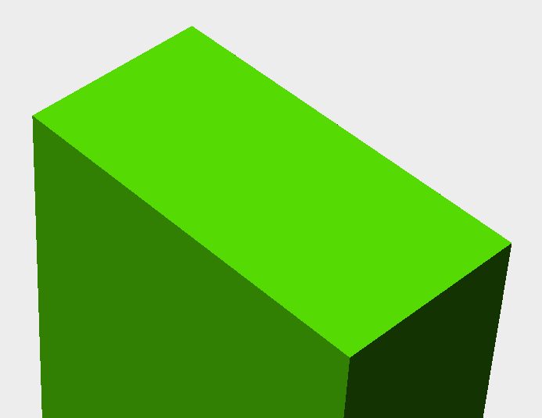
Shading – Diffuse Reflection
Surface’s shaded color may be calculated using Lambertian law
Surfaces reflect more light the more parallel to a light source they become
To calculate the diffuse light reflection component, we need
The angle between the light vector and the surface normal
Use the angle to calculate the actual intensity
Instead of angle, we can use the cos(angle) as it is nicely got from the dot product of two vectors and is in the range [-1, 1]
Get the light vector
vec3 lightVector = normalize(lightPos - vertex);
Uses the dot product to calculate the cosine
float diffuse = max(dot(normalize(vertNormal), lightVector), 0.0);
Calculate the shading value
vec3 col = clamp(ambbientColor + diffuseColor * diffuse, 0.0, 1.0);

Slide 72
Shading – Specular Reflection
Light s reflected mostly in the direction that is the reflection of the light on the surface
Specular color component will be
1, if we are looking into the reflection
< 1, if we are looking elsewhere
Let’s calculate the reflection direction
vec3 reflection = reflect(lightVector, vertexNormal);
Get the cosine between the camera vector and the reflection vector
float cosAlpha = max(dot(cameraVec, reflection), 0.0);
Calculate the shading value
vec3 col = clamp(ambbientColor + diffuseColor * diffuse + specularColor * pow(cosAlpha, specularLobe), 0.0, 1.0);

Slide 73
Shadow Mapping – Render Pass Example
Scene is rendered in two passes
First it is rendered from the point of view of the light
Only the depth of each fragment is computed
Stored in the shadow map
Second the scene is rendered as usual
With an extra test to see, if the fragment is in the shadow
Any fragment, which is further from the light source than shadow map is in the shadow
Distances stored into a texture

Slide 74
Shadow Map Texture
// Create a frame buffer object
Gluint depthBufferHandle = 0;
glGenFramebuffers(1, &depthBufferHandle );
glBindFramebuffer(GL_FRAMEBUFFER, depthBufferHandle );
// Create a depth texture
Gluint depthTexture;
glGenTextures(1, &depthTexture);
glBindTexture(GL_TEXTURE_2D, depthTexture);
glTexImage2D(GL_TEXTURE_2D, 0,GL_DEPTH_COMPONENT16, width, height, 0, GL_DEPTH_COMPONENT, GL_FLOAT, 0); glTexParameteri(GL_TEXTURE_2D, GL_TEXTURE_MAG_FILTER, GL_NEAREST); glTexParameteri(GL_TEXTURE_2D, GL_TEXTURE_MIN_FILTER, GL_NEAREST);
glTexParameteri(GL_TEXTURE_2D, GL_TEXTURE_WRAP_S, GL_CLAMP_TO_EDGE); glTexParameteri(GL_TEXTURE_2D, GL_TEXTURE_WRAP_T, GL_CLAMP_TO_EDGE);
glFramebufferTexture(GL_FRAMEBUFFER, GL_DEPTH_ATTACHMENT, depthTexture, 0);
// No draw to color buffer
glDrawBuffers(GL_NONE);

Slide 75
Shadow Mapping – Transformations
Standard model-view projection matrix used
Model matrix may be anything
View rotates the world, so that in camera space the light direction is –Z
Projection is orthographic, containing the world frustrum
We assume the light source is so far, all light rays are parallel
Shades are trivial
Vertex shader just multiplies each vertex with the projection, view, and model matrixes
Fragment shader fragmentdepth = gl_FragCoord.z;
QVector3D lightInvertedDirection(0.5f, 5, 5);
QMatrix4x4 viewMatrix(lightInvertedDirection.x(), ..., );
QMatrix4x4 projectionMatrix; projectionMatrix.ortho(-20, 20, -20, 20, -20, 20);
// left, right, top, bottom, near, far
glUniformMatrix4fv(depthMatrixID, 1, GL_FALSE, &depthMVP[0][0]);

Slide 76
Shadow Mapping – Usage
Vertex shader is trivial, just multiply each vertex with protection, view, and model matrixes
We need the fragment position in the shadowmap space => need to multiply
In the vertex shader
Compare the vertex position to the shadom map position
If the position is larger, add a shadow color component to the fragment

Slide 77
OpenGL in Qt

Slide 78
Contents
Canvas 3D
OpenGL and QtQuick

Slide 79
3D Canvas
Based on signals and context like 2D canvas
Before the first frame is rendered, initializeGL() emitted
Get the context (provides OpenGL API) - canvas.getContext(“3d”, {depth:true, antialias:true});
Set the rendering buffers
Create buffers
Create shaders
Load textures
For each frame to be rendered, paintGL() emitted
Apply transformations
Draw elements

Slide 80
3D Canvas in QML
import QtQuick 2.4
import QtCanvas3D 1.0
import ”myOpenGLCode.js” as Code
Item {
id: root; width: 640; height: 480; visible: true Canvas3D {
id: canvas3d
anchors.fill:parent
onInitializeGL: {
Code.initializeGL(canvas3d);
} onPaintGL: {
Code.paintGL(canvas3d);
}

Slide 81
3D Canvas in JavaScript
var canvas3d;
var gl;
function initializeGL(canvas) {
canvas3d = canvas;
gl = canvas.getContext("canvas3d", {depth:true, antialias:true});
gl.clearColor(0.98, 0.98, 0.98, 1.0);
gl.viewport(0, 0, canvas.width, canvas.height); initShaders(); initBuffers();
loadTextures(); }
function paintGL(canvas) { gl.clear(gl.COLOR_BUFFER_BIT | gl.DEPTH_BUFFER_BIT); gl.drawElements(gl.TRIANGLES, 36, gl.UNSIGNED_SHORT, 0);
}

Slide 82
OpenGL and QtQuick
QtQuick renderer allows you to use OpenGL
Before a frame is rendered (background)
For the QtQuick custom items
After rendering a frame (foreground)
Possible to use QQuickPaintedItem as well with native painting

Slide 83
GUI thread
Render thread
Demo: customItem
QQuickItem::
update()
Start a new frame
GL Context made current
QQuickItem::
updatePolish()
Begin sync
Block GUI thread
GUI thread blocked
emit QQuickWindow:: beforeSynchronization()
QQuickItem:: updatePaintNode()
Begin sync
Block GUI thread
End sync
Unblock GUI
Continue event loop
emit QQuickWindow:: beforeRendering()
emit QQuickWindow:: afterRendering()
QOpenGLContext:: swapBuffers()
emit QQuickWindow:: frameSwapped()

Slide 84
Scene Graph Nodes and Material Classes

Slide 85
Items and Scene Graph Nodes
Derive from QQuickItem
Implement updatePaintNode(…)
More efficient than paint(), which occurs in two phases – must be painted into the buffer (QSGTextureNode), rendered by the scene graph renderer
Use QSGNode::preprocess(), if the node changes in every frame

Slide 86
Scene Graph Items
Create and initialize a QSGNode subclass (e.g. QSGGeometryNode)
QSGGeometry to specify the mesh
QSGMaterial to encapsulate rendering state for a shader program
For one scene graph, there is one unique QSGMaterialShader, which encapsulates QOpenGLShaderProgram the scene graph uses to render that material
Each geometry node may have a unique QSGMaterial
Similar to other QtQuick classes:
Export object from C++
Import and use in QML
Properties, signals/slots, Q_INVOKABLE

Slide 87
Custom Geometry Node
Use QSGGeometry to define vertices (position, normals, and texture coordinates)
QSGGeometry *geometry = new QSGGeometry(CustomAttributeSet, 3);
Define the drawing mode (triangles, triangle strips or points)
geometry->setDrawingMode(GL_TRIANGLES);
CustomVertex *verteces = static_cast<CustomVertex *>(geometry->vertexData())
vertices[0].set(…);

Slide 88
Custom Geometry Node
Set the geometry to the geometry node
QSGGeometryNode::setGeometry(geometry);
The geometry can be uploaded to the graphics memory
setVertexDataPattern() // AlwaysUploadPattern, DynamicPattern, StaticPattern
Use markVertexDataDorty() to specify, when the geometry should be uploaded, if other than AlwaysUploadPattern used

Slide 89
Custom Material
Subclass QSGSimpleMaterialShader
Use a macro to add boilerplate code
class MyCoolMaterial : public QSGSimpleMaterialShader<StateStruct>
{
QSG_DECLARE_SIMPLE_SHADER(MyCoolMaterial, StateStruct);
Implement the shaders
Implement the state updates
void updateState(const State *state, const State *)
{
program()->setUniformValue(m_stateVariable, state->dataInMyStateStruct); ‘
}
Set the material to the geometry node
QSGSimpleMaterial<StateStruct> *material = MyCoolMaterial::createMaterial();
QSGGeometryNode::setMaterial(material);

Slide 90
Shaders in Qt Quick
Two QML elements: ShaderEffectSource and ShaderEffect
ShaderEffectSource renders any item into a texture
sourceItem property holds the Item to be rendered
The item is drawn as it was a fully opaque root item, even the item is invisible
The texture may be used as a cache (live: false) to render complex items (rendered once to the texture, which can be animated)
Can be used as an opacity layer
Still performance (sometimes drops), video memory (always increases), and quality (anti-aliasing) issues to be considered
ShaderEffect is a rectangle displaying the result of a shader program
The fragmentShader (vertexShader) property is a string with the fragment or vertex shader code
Note that ShaderEffectSource is an invisible element (not rendered itself) aimed at consumption in ShaderEffect instances

Slide 91
Vertex Shaders
Four pre-defined input values provided to a vertex shader
uniform mat4 qt_Matrix // Product of transformations from the root and projection matrix
uniform float qt_Opacity // Product of opacities from the root
attribute vec4 qt_Vertex
attribute vec2 qt_MultiTexCoord0 // from top-left (0,0) to bottom-right [1,1]
Any property that can be mapped to GLSL type is available as a uniform variable
Bool, QColor (vec4), QPoint (vec2), QVector3D (vec3), QTransform (mat4), Image and ShaderEffectSource (sampler2D)

Slide 92
Vertex Shaders
For non-linear vertex transformations, use the mesh property (GridMesh)
Specifies the number of vertices of the ShaderEffect element
It must be large enough to resolve the transformation
Use log property to see the latest warnings and compilation errors of your shader program

Slide 93
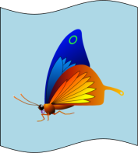
Wave Effect with a Vertex Shader
Demo: vertexShader
ShaderEffectSource {
id: effectSource; ...
}
ShaderEffect { ...
property variant source: effectSource
property real pi: Math.PI
property real offset: 0
NumberAnimation on offset { ... }
mesh: GridMesh { resolution: Qt.size(20, 1) }
vertexShader: "
uniform highp float offset; ...
uniform highp mat4 qt_Matrix;
attribute highp vec4 qt_Vertex;
attribute highp vec2 qt_MultiTexCoord0;
varying highp vec2 qt_TexCoord0;
void main() {
qt_TexCoord0 = qt_MultiTexCoord0;
highp vec4 pos = qt_Vertex;
pos.y = ...;
gl_Position = qt_Matrix * pos;
}"
}

Slide 94
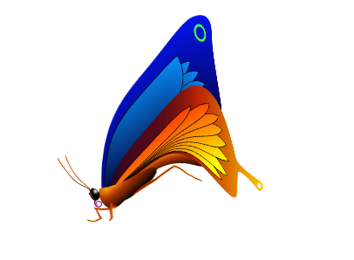
Wave Effect with a Fragment Shader
Demo: fragmentShader
ShaderEffect {
width: 160; height: width
property variant source: sourceImage // Image type
property real frequency: 10
property real amplitude: 0.08
property real time: 0.0
NumberAnimation on time {
from: 0; to: Math.PI*2; duration: 1000;
loops: Animation.Infinite }
fragmentShader: "
varying highp vec2 qt_TexCoord0;
uniform sampler2D source;
uniform lowp float qt_Opacity;
uniform highp float frequency;
uniform highp float amplitude;
uniform highp float time;
void main() {
highp vec2 pulse = sin(time - frequency * qt_TexCoord0);
highp vec2 coord = qt_TexCoord0 + amplitude * vec2(pulse.x, -pulse.x);
gl_FragColor = texture2D(source, coord) * qt_Opacity;
}”

Slide 95

Chaining Shaders
ShaderEffectSource can have any Item as sourceItem
Even a ShaderEffect!
Allows to create complex effects by chaining shader programs
A drop shadow is a combination of:
A blur operation
A darkening of the result of the blur
A composition of the original on top of the created shadow with an offset

Slide 96
Qt 3D

Slide 97
Contents
Features
Entity Component System
Architecture
Frame graph
Materials
Effects

Slide 98
Qt 3D
For general-purpose 2D and 3D (real-time) simulations in C++ and QML
Completely re-designed from v. 1, introduced already in Qt 4.7
Configurable for any kind of 3D simulations
Qt Quick uses scene graph render optimizations (batches, rendering order, texture atlas)
Only vertex and fragment shaders supported
Qt 3D allows the developer to configure the rendering
Multiple render passes, multiple viewports
Any shader type supported (except compute shader)
Optimized performance
Uses threads, running in multiple cores, for simulation tasks (jobs)
3D assets optimizations

Slide 99
Qt Quick vs. Qt 3D Features
Feature | QML | Qt 3D | Remark
2D and 3D rendering | ✔ | ✔
Meshes | ✔ | ✔ | Meshes may be imported in Qt 3D
Materials | ✔ | ✔ | For Qt 3D, can be generated with qgltf
Shaders | ✔ | ✔ | Only vertex and fragments shaders in Qt Quick
Shadow mapping |  | ✔ | With multiple rendering passes
Ambient occlusion |  | ✔
High dynamic range |  | ✔
Deferred rendering | ✔ | ✔ | In QML, using FBOs
Multitexturing |  | ✔
Instanced rendering |  | ✔ | Not supported yet
Uniform buffer objects |  | ✔

Slide 100
Qt 3D Modules
C++
Qt3DCore
Qt3DInput
Qt3DLogic – enables synchronizing frames with the Qt 3D backend
Qt3DRender
Qt3DExtras
Qt Quick
Qt3D.Core
Qt3D.Input
Qt3D.Logic
Qt3D.Render

Slide 101
Architecture
Frontend
Lightweight
QObject subclasses with properties, signals/slots
Non-blocking communication to the backend
Backend
Running in a separate thread
Runs jobs for the frontend objects using the thread pool
Frontend
Provides configuration data
Changes data, notifies observers
Backend
Qt 3D Engine

Slide 102
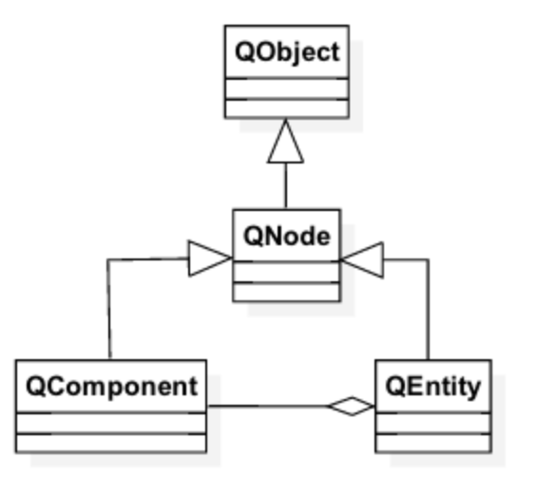
Architecture – Entity Component System (ECS)
A Qt 3D scene consists of a hierarchy of nodes – no deep inheritance
Each node has a unique identifier,
Node property changes are notified to aspects (backend nodes) with NOTIFY signals
An entity aggregates components in a scene
Components are basic frontend classes
An entity may be a 3D object, aggregating mesh, transform, and material components
Frontend nodes are mapped to backend nodes by aspects
Define some slice of behavior, such as rendering, user input or audio
Aspects look for certain components in entities to gather the data, configuring the behavior
Frame or node property change trigger the backend to execute the aspect jobs

Slide 103
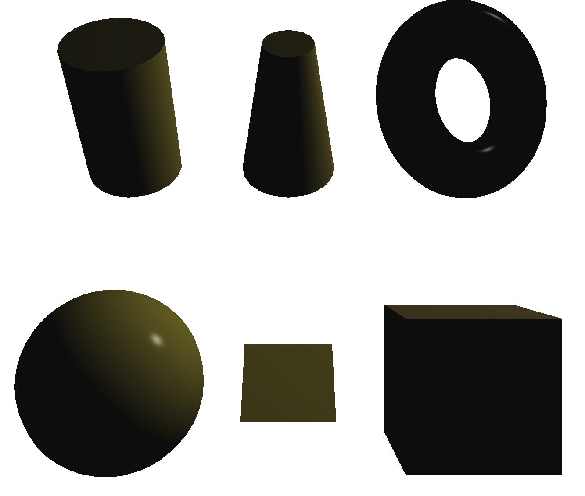
Creating a Scene
Create an entity tree with a root entity
Add components with QEntity::addComponent()
Mesh component - QMesh
Use setSource(const QUrl &) to load a mesh
Qt3DExtras provide a few pre-defined meshes: torus, cylinder, cone, cube, plane, sphere
Material component - QMaterial
Use materials from Qt3DExtras or implement a custom material
Transform component - QTransform
Use static functions to create a 4x4 matrix or quaternion

Slide 104
Creating a Scene
Create and setup at least one camera entity - QCamera
Set camera position and projection
Setup and configure each entity behavior
Create an aspect engine (QAspectEngine), handling the registered aspects
QRenderAspect, QInputAspect, QLogicAspect, CustomAspect
Configure the aspect behavior with components and related nodes and add components to your entities
QRenderSettings, QInputSettings // examples of components
QForwardRenderer, QViewport, QAction, QAxis // examples of nodes
Finally, a window is needed - QOpenGLWindow, QQuickWindow
Qt3DExtras::Qt3DWindow creates a window with the default camera and render, input, and logic aspects
In Qt Quick apps, use Qt3DExtras::Quick::Qt3DQuickWindow

Slide 105
Good Practices
Have a Qt3DCore::QEntity to represent the scene
Have one Qt3DCore::QEntity per “object” in the scene
Attach Qt3DCore::QComponent subclasses to objects to define the behaviour

Slide 106

Creating a Scene in C++
Demo: Qt3DScene
int main(int argc, char* argv[])
{
QGuiApplication app(argc, argv);
Qt3DExtras::Qt3DWindow view; Qt3DCore::QEntity scene;
// Material, mesh, and transform properties omitted
Qt3DRender::QMaterial *material = new Qt3DExtras::QPhongMaterial(&scene);
Qt3DCore::QEntity *torusEntity = new Qt3DCore::QEntity(&scene);
Qt3DExtras::QTorusMesh *torusMesh = new Qt3DExtras::QTorusMesh;
Qt3DCore::QTransform *torusTransform = new Qt3DCore::QTransform;
torusEntity->addComponent(torusMesh);
torusEntity->addComponent(torusTransform);
torusEntity->addComponent(material); Qt3DRender::QCamera *camera = view.camera(); // View crates a default camera
camera->lens()->setPerspectiveProjection(45.0f, 16.0f/9.0f, 0.1f, 1000.0f);
view.setRootEntity(&scene); view.show();
return app.exec();
}

Slide 107
Creating a Scene in QML
Demo: Qt3DQuickScene
QGuiApplication app(argc, argv);
Qt3DExtras::Quick::Qt3DQuickWindow view;
view.setSource(QUrl("qrc:/main.qml"));
view.show();
Entity {
Camera {
id: camera
projectionType: CameraLens.PerspectiveProjection; fieldOfView: 45; aspectRatio: 16/9
nearPlane: 0.1; farPlane: 1000.0; position: Qt.vector3d( 0.0, 0.0, -40.0 )
upVector: Qt.vector3d(0.0, 1.0, 0.0); viewCenter: Qt.vector3d(0.0, 0.0, 0.0)
}
components: [
RenderSettings { activeFrameGraph: ForwardRenderer { camera: camera } },
InputSettings { } ]
Entity {
id: torusEntity
components: [ torusMesh, material, torusTransform ]
} PhongMaterial { id: material; diffuse: Qt.rgba(1.0, 0, 0, 0) } TorusMesh { id: torusMesh; radius: 5; minorRadius: 1; rings: 100; slices: 20 } Transform { id: torusTransform; scale3D: Qt.vector3d(1.5, 1, 0.5);
rotation: fromAxisAndAngle(Qt.vector3d(1, 0, 0), 45) } }

Slide 108
Mesh Loading
Mesh is loaded by scene parser plugin
Assimp plugin uses Open Asset Library to load different asset formats
glTF plugin loads GL Transmission Format files
Assets can be converted and optimized into glTF using qgltf tool
Can generate a compressed, binary JSON file, describing the scene
Can generate tangent vectors and scale vertices during build time
Can generate techniques and GLSL 1.00 and 1.50 shaders (materials)
Can compress texture assets (PNG only)
# .pro file
QT3D_MODELS += assets/3d/ferrari.obj assets/3d/lamborgini.obj
# -b use binary JSON file, -g generate OpenGL 3.2+ core profile shaders too
QGLTF_PARAMS = -b -g
load(qgltf)

Slide 109
Making the Scene Alive – Aspects
Aspects (QAbstractAspect) define a vertical slide of behavior
Developers configure the behavior in aspect-specific components (frontend nodes), added to entities
The aspect maps frontend components to backend nodes
Changes in frontend nodes are notified to backend nodes
Backend nodes may notify frontend nodes as well
Behaviour comes from aspects processing component data
Aspects are registered with QAspectEngine, who will become the owner of aspects
Registered aspects are accessed from QAspectManager, which is running the simulation event loop in the aspect thread
For each frame, the manager asks aspects for jobs to be executed by the thread pool threads

Slide 110
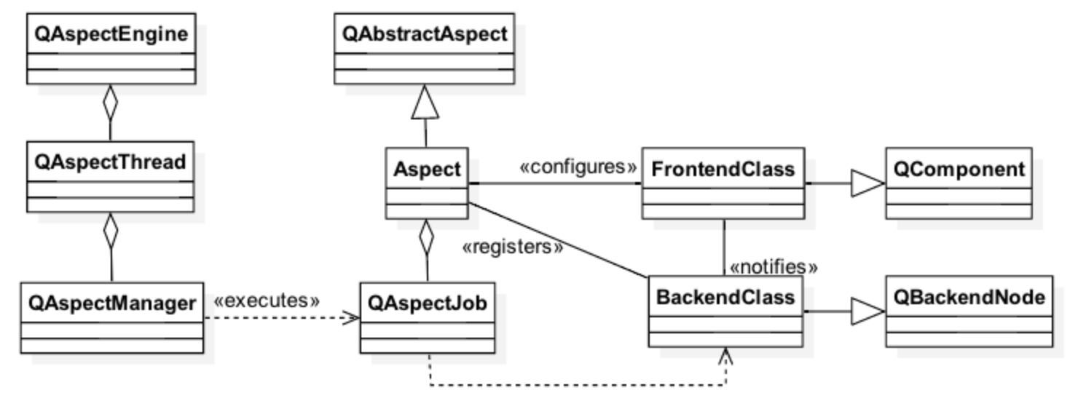
Qt 3D Backend Engine
Frontend

Slide 111
QLogicAspect
Handles frame synchronization jobs
Only one frontend component – QFrameAction
Emits a signal just before the current buffer is swapped
Useful for animations synchronized with the Qt 3D engine backend
E.g. check input and transform an entity or camera in the slot
void AnEntity::init()
{
m_frameAction(new Qt3DLogic::QFrameAction());
// float argument gives the elapsed time since the last frame in ms
QObject::connect(m_frameAction, SIGNAL(triggered(float)), this, SLOT(onTriggered(float)));
addComponent(m_frameAction);
}

Slide 112
QInputAspect
Two essential configuration components
QInputSettings define the event source
Qt3DExtras::Qt3DWindow sets the window itself as an event source
QLogicalDevice defines, which actions (QAction) an entity uses
The input aspect provides jobs to handle actions for the backend engine
Jobs notify frontend components about input events
QAction links together action inputs, which trigger the same event
Action inputs store physical devices and buttons, triggering an event
In addition to actions, input may affect the axis (QAxis)
Like actions, QAxis stores axis inputs, which trigger an event

Slide 113
Basic Input
Physical devices (QMouseDevice, QKeyboardDevice, QGamepadInput) dispatch events to input handlers
Input handlers (QKeyboardHandler, QMouseHandler) provide event notifications when attached to physical devices
clicked(), entered(), pressed(), released()
Qt3DRender::ObjectPicker component provides high level picking
Ray-cast-based picking

Slide 114
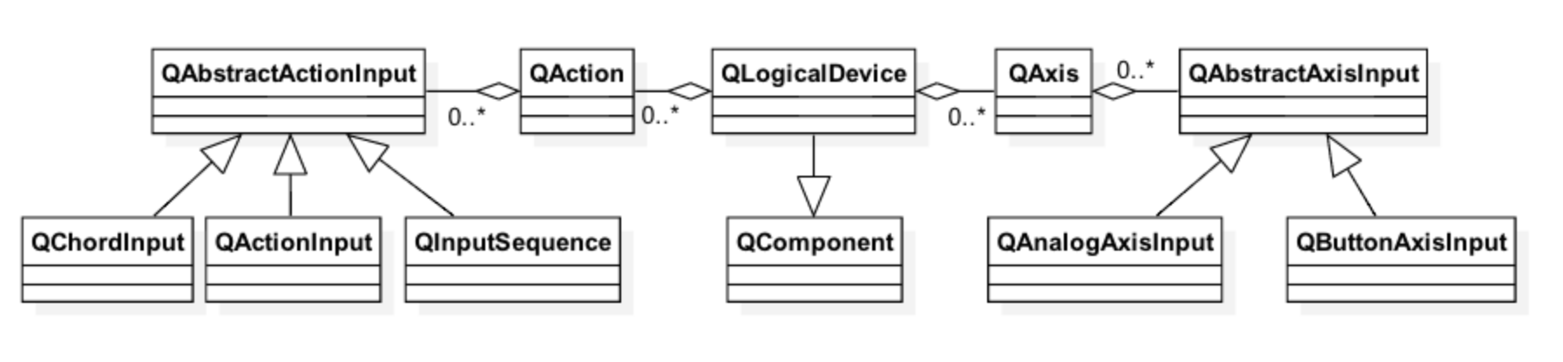
Advanced Input
Provided by logical devices QLogicalDevice
Maps physical devices
Supports collections of actions and analog axis values

Slide 115
Using Input Aspect Front End
Demo: Qt3DInputAspect
CameraController::CameraController(Qt3DCore::QNode *parent) :
Qt3DCore::QEntity(parent),
m_logicalDevice(new Qt3DInput::QLogicalDevice(),
m_mouseDevice(new Qt3DInput::QMouseDevice()),
m_leftMouseButtonAction(new Qt3DInput::QAction()),
m_rxAxis(new Qt3DInput::QAxis()),
m_mouseRyInput(new Qt3DInput::QAnalogAxisInput()) // + other actions, axes, and inputs
{ // Left Mouse Button Action
m_leftMouseButtonInput->setButtons(QVector<int>() << Qt::LeftButton);
m_leftMouseButtonInput->setSourceDevice(m_mouseDevice);
m_leftMouseButtonAction->addInput(m_leftMouseButtonInput); // Mouse X axis
m_mouseRxInput->setAxis(Qt3DInput::QMouseDevice::X);
m_mouseRxInput->setSourceDevice(m_mouseDevice); m_rxAxis->addInput(m_mouseRxInput); // Logical device
m_logicalDevice->addAction(m_leftMouseButtonAction);
m_logicalDevice->addAxis(m_rxAxis);
addComponent(m_logicalDevice);
// + other actions, axes, and inputs
}

Slide 116
Using Input Aspect Front End
Demo: Qt3DInputAspect
void CameraController::frameActionTriggered(float dt)
{
// Mouse input
if (m_leftMouseButtonAction->isActive()) {
if (m_rightMouseButtonAction->isActive()) {
//Do something with the input value
m_camera->translate(QVector3D(0, 0, m_ryAxis->value()),
m_camera->DontTranslateViewCenter);
}
}
}

Slide 117
Custom Aspects
Subclass at least QAbstractAspect and QAspectJob
Additionally, any number of backend classes, executed by the aspect engine and corresponding frontend classes with configurable properties
QAbstractAspect
onRegistered() low the aspect to do some work now that it is registered
onEngineStartup()
Behavior consists of a set of jobs and commands, created in the backend nodes
virtual QVector<QAspectJobPtr> jobsToExecute(qint64 time);
virtual QVariant executeCommand(const QStringList &args);
QAspectJob
Has pure virtual run() function
Jobs may have dependencies => queued by the same thread

Slide 118
Frontend
Rather basic QObject subclass
Typically derived from Node or Component
Add properties for providing data to backend nodes
Add signals for backend communication and for notifying entities
class FrontendClass: public Qt3DCore::QComponent
{
Q_OBJECT
Q_PROPERTY(bool focus READ focus WRITE setFocus NOTIFY focusChanged)
public:
explicit FrontendClass(QNode *parent = nullptr);
~FrontendClass(); Q_SIGNALS:
void focusChanged(bool focus);

Slide 119
Aspect
Map frontend and backend nodes
Nodes are created, if needed
Provide jobs
Jobs are executed for each frame
CustomAspect::CustomAspect(QObject *parent)
: QAbstractAspect(parent)
{
registerBackendType<FrontendClass>(QBackendNodeMapperPtr(
new BackendNodeFunctor(this, m_handler.data())));
}
QVector<QAspectJobPtr> CustomAspect::jobsToExecute(qint64 time)
{ QVector<QAspectJobPtr> jobs; jobs.append(m_handler->jobs());
}

Slide 120
Backend Nodes
Derive from QBackendNode
Use sceneChangeEvent() to notify property changes in the frontend class
initializeFromPeer() is used for further initialization after the backend has been created
Nodes or node ids often managed by a custom class
class BackendNode : public Qt3DCore::QBackendNode
{
public:
BackendNode(); void sceneChangeEvent(const Qt3DCore::QSceneChangePtr &e) Q_DECL_OVERRIDE; protected:
void requestFocus(); private:
void initializeFromPeer(const Qt3DCore::QNodeCreatedChangeBasePtr &change) Q_DECL_FINAL; Handler *m_Handler;
bool m_focus;
};

Slide 121
Backend Node Mapper
Creates and maps backend nodes
Qt3DCore::QBackendNode *BackendFunctor::create(const Qt3DCore::QNodeCreatedChangeBasePtr &change) const
{
BackendNode *node = m_handler->resourceManager()->getOrCreateResource(change->subjectId());
node->setCustomAspect(m_customAspect);
node->setHandler(m_handler);
return node;
} Qt3DCore::QBackendNode *BackendFunctor::get(Qt3DCore::QNodeId id) const
{
return m_handler->resourceManager ()->lookupResource(id);
} void QBackendNode ::destroy(Qt3DCore::QNodeId id) const
{
m_handler->removeBackendNode(m_handler->resourceManager()->lookupHandle(id));
m_handler->resourceManager ()->releaseResource(id);
}

Slide 122
Jobs
Implement the required behavior
Notify frontend by using properties or signals
void Handler::keyEvent(const QKeyEventPtr &event)
{
auto e = Qt3DCore::QPropertyUpdatedChangePtr::create(peerId());
e->setDeliveryFlags(Qt3DCore::QSceneChange::DeliverToAll);
e->setPropertyName("event");
e->setValue(QVariant::fromValue(event));
notifyObservers(e);
}
void AnotherHandler::triggerSignal()
{ // Send an event to an object in GUI thread. That object asks frontend class to emit signals
qApp->postEvent(m_notifier, new CustomEvent(m_dt));
}

Slide 123
Materials and Effects
Materials specify the rendering of an entity
QPhong(Alpha)Material, QPerVertexColorMaterial, QDiffuseMapMaterial, QNormalDiffuseMapMaterial
Effect defines with a technique, how the material is rendered
Easy to change the effect without touching any shader code
Material properties are defined with <name, value> pairs – QParameter
Textures, lighting, colors
Parameters are exposed to shaders as uniforms
In a material class: QParameter(QStringLiteral(“aColor”),
QColor::fromRgbF(0.01f, 0.01f, 0.01f, 1.0f))
In a shader: uniform vec4 aColor;

Slide 124
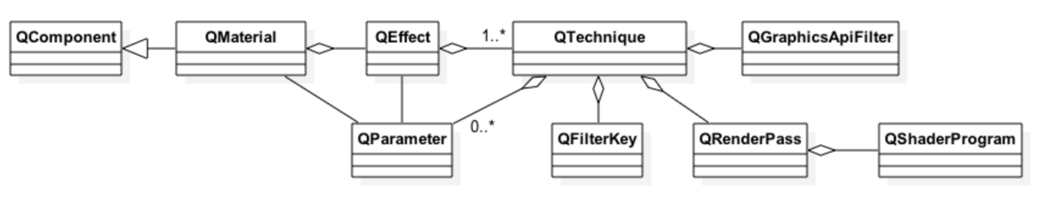
Material Techniques
Material is rendered using one of possibly several rendering techniques
QGraphicsApiFilter defines the required API for the technique
OpenGL version, profile, platform
QFilterKey(s) define, when the renderer should use the defined rendering configuration
QRenderPass defines the shader program and render state
QRenderState allows modifying global render state (blend, clip, stencil, color mask properties)

Slide 125
Custom Material
Demo: Qt3DCustomAspect
CustomMaterial::CustomMaterial(QNode *parent)
: QMaterial(parent), m_materialGL3Shader(new QShaderProgram(this)), // allocate other members
{
m_myParameter = new QParameter(QStringLiteral("parameterName"), 42);
// Notify parameter changes with parameter-specific signals: void parameterNameChanged(int)
connect(m_myParameter, &Qt3DRender::QParameter::valueChanged, this, … );
m_materialGL3Shader ->setVertexShaderCode(QShaderProgram::loadSource(QUrl( … ));
// Similarly shader program for OpenGLES etc.
// Define the OpenGL version and profile required
m_materialGL3Technique->graphicsApiFilter()->setApi(QGraphicsApiFilter::OpenGL); m_materialGL3RenderPass->setShaderProgram(m_materialGL3Shader);
m_materialGL3Technique->addRenderPass(m_materialGL3RenderPass);
m_filterKey->setName(QStringLiteral("renderingStyle"));
m_filterKey->setValue(QStringLiteral("forward")); m_materialGL3Technique->addFilterKey(m_filterKey);
m_customEffect->addTechnique(m_materialGL3Technique);
m_customEffect->addParameter(m_myParameter);
setEffect(m_customEffect);
}

Slide 126
Textures and Lights
Subclasses of Qt3DRender::QAbstractTexture provide various texture types
1D – useful for lookup functions
2D – most commonly used
3D – typically volumetric data
Arrays of 2D…
Qt3DRender::QTextureLoader supports all texture types loaded from DDS files
The built-in materials work with lights - Qt3DRender::QAbstractLight component
Point light
Directional light
Spotlight
Lights do not get rendered, we only see their effect on other entities

Slide 127
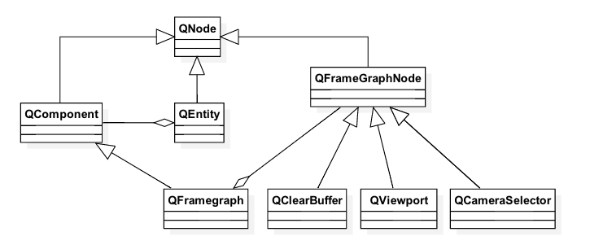
Rendering – Render Aspect
Draws entities with a shape and material
Uses a frame graph node for describing the rendering algorithm
Render settings component defines the active frame graph
Data-driven – can be changed dynamically at run time
Several node types for selecting the camera, render target, layers of entities, viewport dimensions, render state, material etc.
Notes:
RenderViewJob)
QRenderAspect looks for entities, having render settings, mesh, material, and optionally transform components

Slide 128
Frame Graph
Often rendering a single frame requires states and data sets
Each path to a render graph leaf defines a state (RenderView)
Renderer uses the depth-first search to collect state information from the graph nodes
Renderer collects all entities to be rendered into a set of RenderCommands and associates a RenderView with them
RederView and RenderCommands are passed over for submission to OpenGL
Forward rendering, deferred rendering, reflections, shadows, multiple viewports etc.
The actual shaders selected using RenderPassFilter and Annotations
Select only Entities in the scene that have a Material and Technique matching the annotations in the RenderPassFilter

Slide 129
Single Render Pass
Entity {
id: sceneRoot Camera {
id: camera
projectionType: CameraLens.PerspectiveProjection
fieldOfView: 45
nearPlane : 0.1
farPlane : 1000.0
position: Qt.vector3d(0.0, 0.0, 40.0)
upVector: Qt.vector3d( 0.0, 1.0, 0.0 )
viewCenter: Qt.vector3d( 0.0, 0.0, 0.0 )
} components: [
RenderSettings {
activeFrameGraph: ForwardRenderer {
camera: camera
clearColor: "transparent"
}
},
InputSettings { }
]

Slide 130
Multiple Render Passes
RenderSettings {
id: root readonly property Texture2D shadowTexture: depthTexture activeFrameGraph: Viewport {
normalizedRect: Qt.rect(0.0, 0.0, 1.0, 1.0) RenderSurfaceSelector {
RenderPassFilter {
matchAny: [ FilterKey { name: "pass"; value: "shadowmap" } ] RenderTargetSelector {
target: RenderTarget {
attachments: [
RenderTargetOutput { objectName: "depth"
attachmentPoint: RenderTargetOutput.Depth
texture: Texture2D {} } ] } ClearBuffers { buffers: ClearBuffers.DepthBuffer CameraSelector { id: lightCameraSelector } } } }
RenderPassFilter { matchAny: [ FilterKey { name: "pass"; value: "forward" } ] ClearBuffers { clearColor: Qt.rgba(0.0, 0.4, 0.7, 1.0)
buffers: ClearBuffers.ColorDepthBuffer CameraSelector { id: viewCameraSelector } } } } } }

Slide 131
Performance Considerations
Startup time
Postpone memory allocations – use lazy loading
Use compressed texture formats
Use qltf for 3D assets
Shared backend nodes
GUI thread
Do not overload GUI thread with notify events
Rendering
Minimize the number of RenderViews
Put state that remains constant longest close to the root node
Qt 3D profiler tool lab exists in code.qt.io

Slide 132
Summary
Qt3D provides a general-purpose framework for creating near real-time 2D/3D simulations
Compared to QML scene graph, which minimizes the number of state changes using batches, Qt3D uses a frame graph to make it easy to manage a set of states in a frame
Developer provides an ECS tree, defining what to render (3D world)
Qt3D engine uses aspects, which are component sets aggregating entities, to define the behavior of 3D world entities
Render uses a frame graph to easily allow developers to change, how the world entities are rendered

Slide 133
Data Visualization

Slide 134
Contents
Types
Item Model Use
Rendering
Customization
Performance

Slide 135
Data Visualization
Module, allowing data to be visualized as 3D bars 3D scatter, and 3D surface
Similar interactions to Qt Charts: rotate, zoom, data highlight
OpenGL-based rendering
Customizable: themes, input handling, items, labels
2D slice views of the 3D data
Item model support
Perspective and orthographic projections
Volumetric custom items

Slide 136
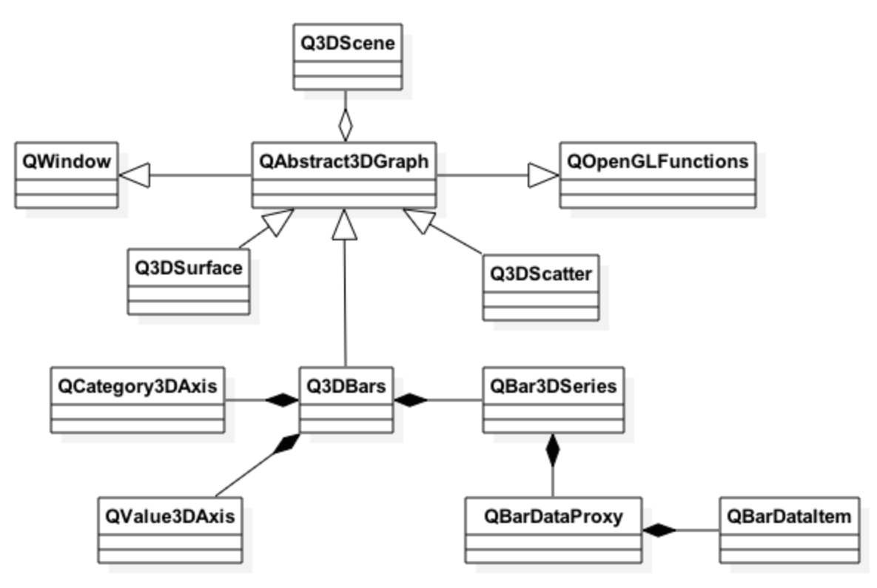
Architecture
3D data is renderer in one of QWindow sub-classes
Defines a render loop for the visualization type
Q3DBars (Bars3D), Q3DSurface (Surface3D), Q3DScatter (Scatter3D)
By default a frameless window
By default anti-aliasing enabled
Data items are handled with visualization type-dependent proxies
BarDataProxy, SurfaceDataProxy, ScatterDataProxy
Uncreatable types, but provide properties for creatable sub-types

Slide 137
Architecture
Data items are provided to windows using data series
Defines how data items in the proxy should be rendered (mesh, baseColor, itemLabel, itemLabelFormat)
Bar3DSeries, Surface3DSeries, Scatter3DSeries
Series may own only a single proxy at a time
Windows may have several series though
Switching series is typically more efficient than switching proxies

Slide 138
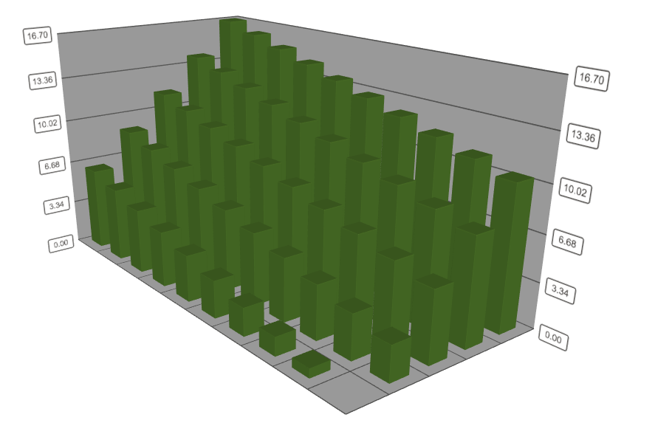
Data Visualization Hello World
Demo: dataVisualization-helloWorld
int main(int argc, char *argv[])
{
QApplication a(argc, argv); Q3DBars graph; QBarDataProxy *newProxy = new QBarDataProxy;
QBarDataArray *dataArray = new QBarDataArray;
dataArray->reserve(10);
for (int i = 0; i < 10; i++) {
QBarDataRow *dataRow = new QBarDataRow(5);
for (int j = 0; j < 5; j++)
(*dataRow)[j].setValue(0.7 * i + 2.6 * j);
dataArray->append(dataRow);
} newProxy->resetArray(dataArray);
QBar3DSeries *series = new QBar3DSeries(newProxy); graph.addSeries(series);
graph.show();
return a.exec();
}

Slide 139
Data Handling in C++ Proxies
Proxies handle adding, inserting, changing, and removing data items
Proxies use signals to notify the graph about data changes
If data items are manipulated directly without using proxy member functions, developer should take care of emitting the signals
Bar data proxy
Owns QBarDataItem objects, providing two floats: value and rotation
Data may be added row by row using QBarDataRow (QVector <QBarDataItem>)
Several rows may be added using QBarDataArray container (QList<QBarDataRow *>)
Possible to store row and column labels as well
In a similar way
Surface data items, providing a 3D position, may be added to the surface proxy
Scatter data items, providing a 3D position and rotation, may be added to the scatter proxy (QScatterDataRow does not exist though)

Slide 140
Data Mapping from Item Models
Provided by item model data proxies, which are proxy sub-types
ItemModelBarDataProxy, ItemModelSurfaceDataProxy, HeightMapSurfaceDataProxy, ItemModelScatterDataProxy
Set a model used by the proxy (QML model or QAbstractItemModel)
Define how model items are mapped to data visualization item fields (rows, columns, value)
Use model categories (useModelCategories = true)
In C++, QAbstractItemModel rows and columns mapped to C++ Q3D<visualization type> rows and columns
In QML, custom categories ignored
Define, which item model roles are mapped to graph rows, columns, and data
rowRole, columnRole, valueRole
Define an explicit list of categories for rows and columns
Allows defining which rows and columns are included and in which order

Slide 141
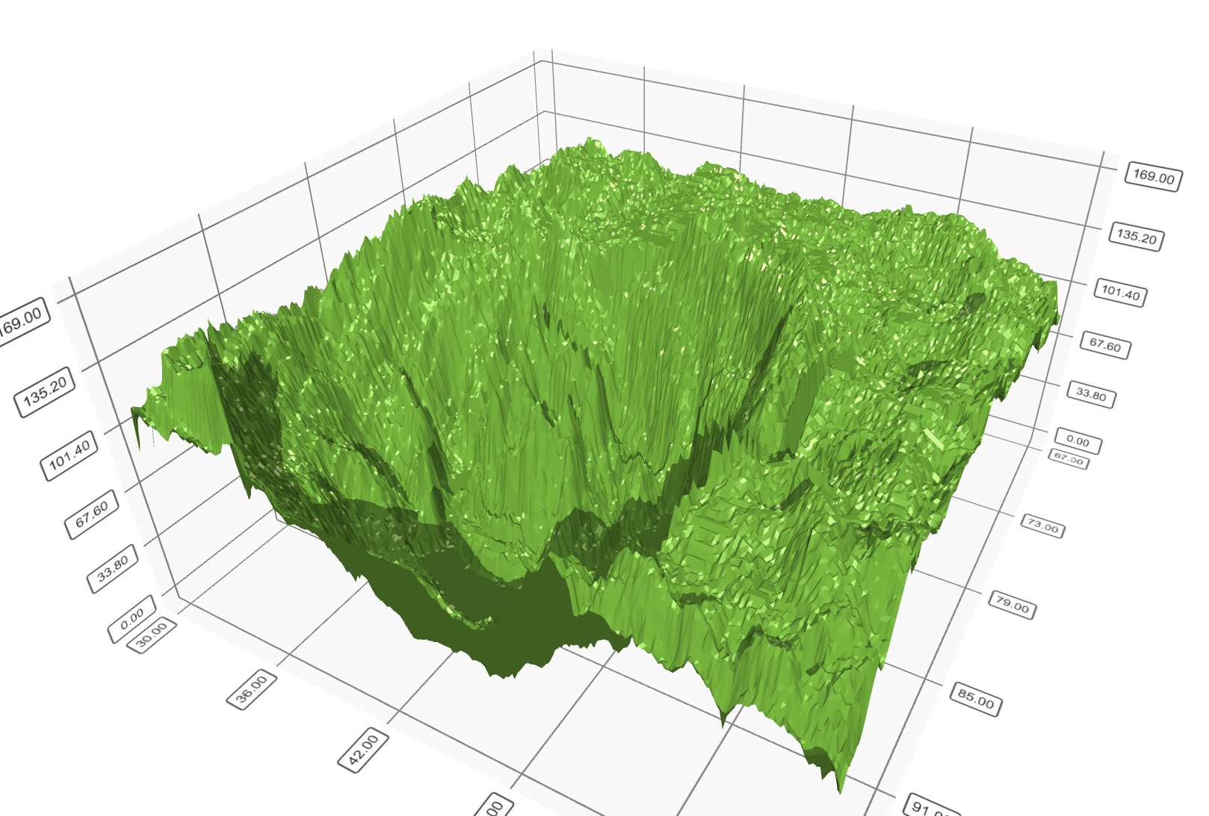
Data Visualization Hello World in QML
Demo: modelMapping
Using HeightMapSurfaceDataProxy
Y value read from the height map file
Preferred format QImage::Format_RGB32 in grayscale (height value from red component)
X and Z range set manually (or with default values)
Surface3D {
id: surfacePlot
width: surfaceView.width; height: surfaceView.height
Surface3DSeries {
id: heightSeries
drawMode: Surface3DSeries.DrawSurface HeightMapSurfaceDataProxy {
heightMapFile: ":/heightmaps/image”
minZValue: 30; maxZValue: 60; minXValue: 67; maxXValue: 97
} }
}

Slide 142
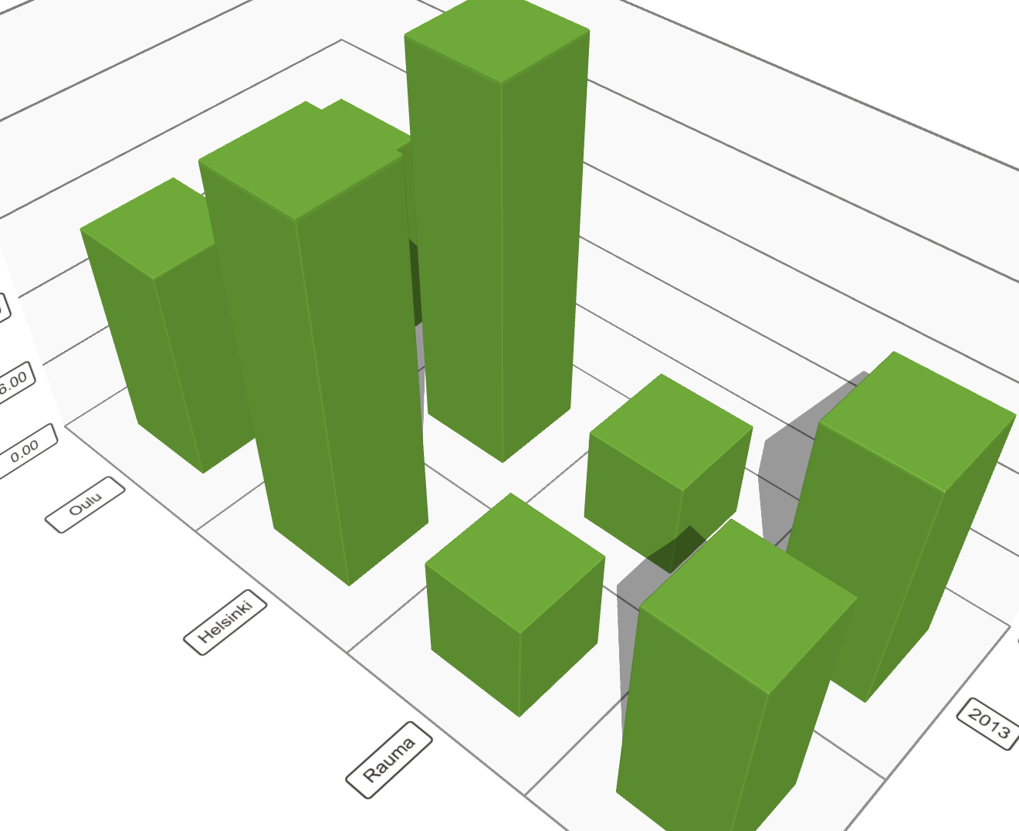
Data Visualization Hello World 2 in QML
Same role values can be handled using multiMatchBehavior
First or last value used, average or cumulative value
Bars3D {
width: parent.width height: parent.height
Bar3DSeries {
itemLabelFormat: "@colLabel, @rowLabel: @valueLabel”
ItemModelBarDataProxy {
itemModel: dataModel; autoColumnCategories: false
rowRole: "year”; columnRole: "city”; valueRole: "expenses"
rowCategories: ["2010", "2011", "2012", "2013"]
columnCategories: ["Oulu", "Helsinki", "Rauma", "Tampere"]
ListModel {
id: dataModel
ListElement{ year: "2012"; city: "Oulu"; expenses: "4200"; }
ListElement{ year: "2012"; city: "Rauma"; expenses: "2100"; }
ListElement{ year: "2012"; city: "Helsinki"; expenses: "7040"; }
// Clipped
}

Slide 143
Sharing Roles with Several Categories
Possible to use regular expressions search patterns and replace rules to format the value for each role before it is used in the category
For example, we want to share timestamp role (date) with two categories: year and month
ListElement{ timestamp: "2006-01"; expenses: "-4"; income: "5" }
ItemModelBarDataProxy {
itemModel: graphData.model
rowRole: "timestamp”; columnRole: "timestamp”; valueRole: "expenses”
rowRolePattern: /^(\d\d\d\d).*$/
columnRolePattern: /^.*-(\d\d)$/
valueRolePattern: /-/
rowRoleReplace: "\\1"
columnRoleReplace: "\\1"
multiMatchBehavior: ItemModelBarDataProxy.MMBCumulative
}

Slide 144
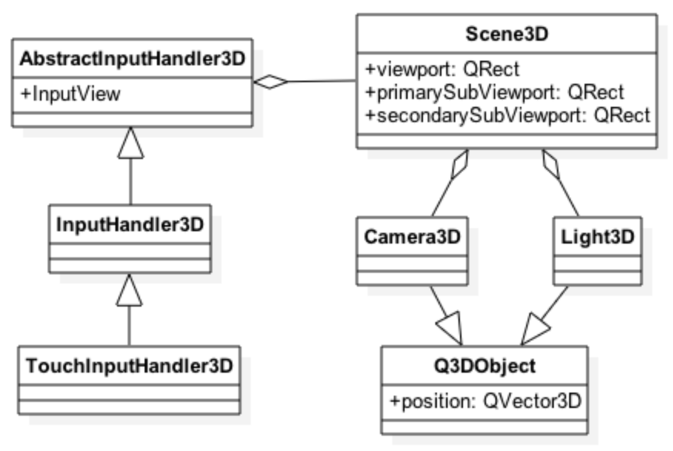
Data Interactions
Implemented in input handlers
Translate events to scene camera and light movements
And to slicing and selection events in the scene
Scene3D
Defines a single active camera and light source
Keeps track of the viewport in which visualization rendering is done
Camera3D represents an orbit around a centerpoint, where data items are rendered
Properties: zoomLevel(100.0) in percentage, minZoomLevel(10.0), maxZoomLevel(500.0), target(0.0, 0.0, 0.0), xRotation and other rotations around the target point
Light 3D represents a monochrome light source

Slide 145
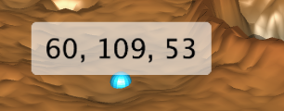
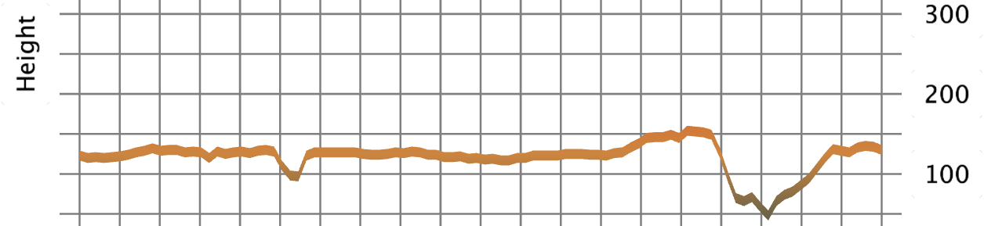
Selections
All graphs support selection of a single data item
Bar and surface graphs support also slice selection mode
Enumeration in AbstractGraph3D
Selected row or column drawn in a separate viewport as a 2D graph
Signals may be used to customize the selection behavior
Bar3DSeries.onSelectedBarChanged(), Scater3DSeries.onSelectedItemChanged(), Surface3DSeries.onSelectedPointChanged()
Mode: SelectionItem
Mode: SelectionSlice | SelectionRow

Slide 146
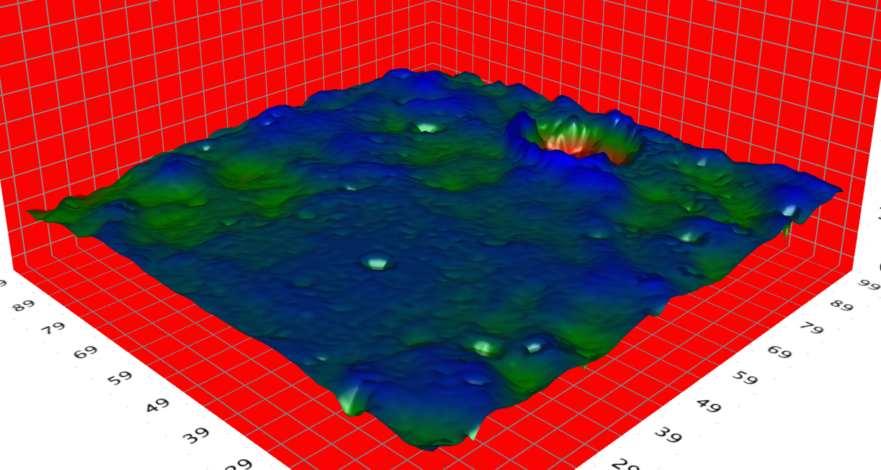
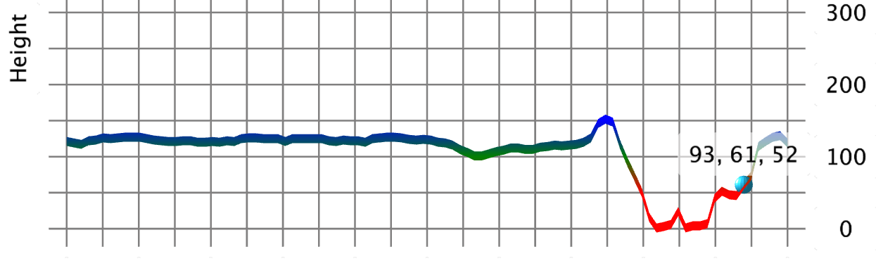
Customization - Theming
Set a built-in theme or a custom theme to theme (Theme3D) property of your graph
Affects the whole graph
Built-in themes: ThemeQt, ThemePrimaryColors, ThemeDigia, ThemeStoneMoss…
Some Theme3D properties: baseColors, baseGradients, colorStyle(uniform, object gradient, range gradient), font, gridEnabled, lightColor, singleHighlightColor
Surface3D {
theme: Theme3D {
type: Theme3D.ThemePrimaryColors
backgroundColor: "red"
font.family: "STCaiyun”; font.pointSize: 35
colorStyle: Theme3D.ColorStyleRangeGradient
baseGradients: [surfaceGradient] }

Slide 147
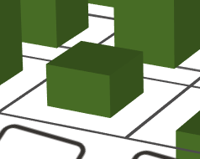
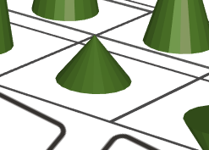
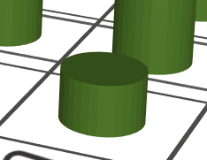
Customization – Items
Plenty of pre-defined item mesh types
Rectangular bar, cube, triangular pyramid, four-sided pyramid, 2D point, cone, cylinder, sphere, arrow pointing upwards
Custom mesh may be defined as well
Bar3DSeries.mesh: Bar3DSeries.MeshUserDefined
Bar3DSeries.userDefinedMesh(“qrc:/meshes/coolMesh.obg”)
Mesh needs to include vertices, normals, and UVs (texture coordinates) and needs to be in triangles
Colors, gradients, and highlight colors can be defined as in theming

Slide 148
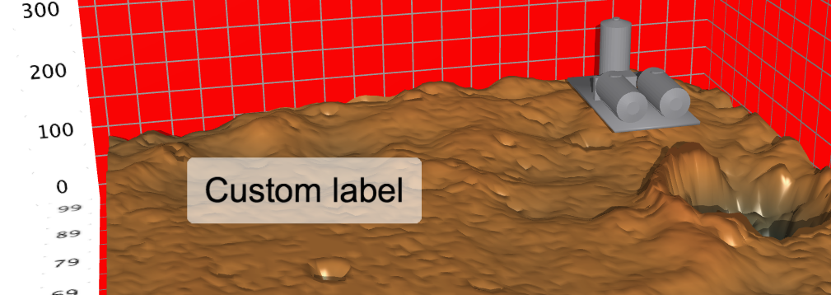
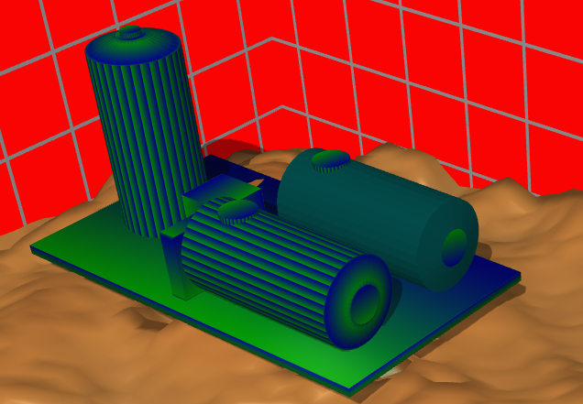
Customization – Items
It is possible to add custom items to the graph
With a mesh and optional texture file
Without texture file, solid gray color is used
Surface3D {
customItemList: [
Custom3DLabel {
text: qsTr("Custom label")
facingCamera: true
scaling: Qt.vector3d(1.0, 1.0, 1.0)
position: Qt.vector3d(20.0, 400.0, 2.0) },
Custom3DItem {
position: Qt.vector3d(80.0, 150.0, 80.0)
meshFile: ":/refinery.obj”
}
]
}

Slide 149
Customization – Other Properties
Shadows
AbstractGraph3D.shadowQuality: disabled, low, medium, high
Reflections
Affects only Bars3D containing only positive or negative values (not both)
Bars3D.reflection: true; Bars3D.reflectivity: 0.9
Locale
Affects number formats
Margin
Between the graph itself and possible labels
Defined as a fraction of Y axis range
FPS
Shows currentFps, if turned on

Slide 150
Performance
Try to re-use existing data sets (possibly with new values) between frames to minimize the number of memory allocations
Commit data changes in batches (e.g. addRows()) in data proxies, if those are used
Adding data to bars or surface data proxies does not have a big effect on rendering performance
Adding data similarly to the scatter data proxy requires all data points to be checked for visibility
It is not recommended to continuously add data items to the scatter data proxy
The best performance is achieved by rendering a graph or graphs to the window background
AbstractGraph3D.renderingMode
Background rendering disables some item behavior like Z-order
Rendering optimization
AbstractGraph3D.renderingOptimization
Default
Static: optimal for large non-changing data sets on Scatter graphs

Slide 151
Limitations
Re-parenting a graph to an item in another window not supported
Only OpenGL ES emulation available for SW renderer
Items outside straight rows or columns on the surface graphs may get clipped incorrectly
Surfaces with a lot of visible vertices may not render, as the per-draw count is exceeded
Some limitations in OpenGL ES (and Angle builds)
Shadows not supported
Anti-aliasing does not work
Custom3DVolume not supported

Slide 152
Thank you
NN@qt.io

